Slide 1
Cognitive Contexts of Ethical Practice: A Phenomenological Study of Nurse Managers
University of Phoenix
Dissertation
January 13, 2021
By: Jennifer Fosty, Ph. D., RN, OCN
Linda Amankwaa, Ph. D., RN, FAAN
Mirella Brooks, Ph. D., FNP-BC, AONP-BC
Suzanne Moss-Richins, DHA, FACHE

Slide 2
Introduction
Why Ethics And Leadership?
The changing environment of the current healthcare is dynamic and redefining the role of frontline nurse leaders in their management role.
Globalization of society
Advanced technology
Economic constraints…
…require that ethical dimensions for providing care requires leadership at all levels of care.
2

Slide 3
Introduction: Background
Organizational Ethics and Moral Leadership
The focus of organizational ethics is on:
Practicing conduct of healthcare managers
Reports by healthcare practitioners for incongruent practices of patient values with organizational demands
The health of the workplace environment for practicing in an ethical manner filled with multi-dimensional workplace ethics
Concerns with ethical dimensions of managerial decision-making affect all stakeholders of the organization
(Suhonen et al., 2011)
3

Slide 4
Research Question
Introduction
What are frontline nurse managers lived experiences of ethical dilemmas in the workplace?
4

Slide 5
Literature Review
Ethics in the workplace
Searches include keywords and topics on individual ethics
Prominent researchers on the topic
5

Slide 6
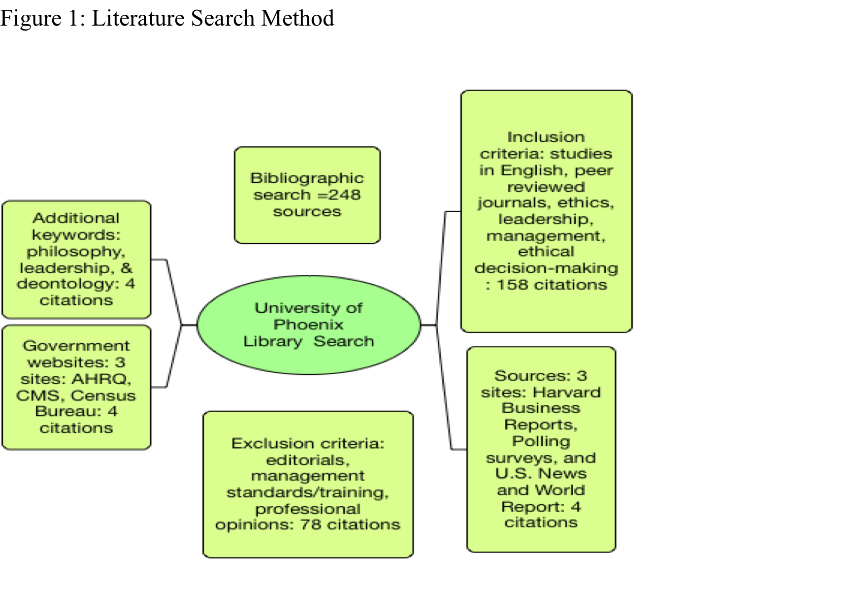
Literature Review
Literature Search Methods
6

Slide 7
Literature Review
Ethical Decision-Making
Individual (attitude)
Subjective
Objective
Organizational (Judgment & Intention)
Ethical
Legal
Issue Contingent (Ethical Behavior)
Values
Compromises
Individual: Perspectives, Values,
Organizational: Goals, Legal, Ethical
Issue Contingent: Personal versus Pro-Social Gains
(Azjen & Fishbein, 1980; Craft, 2013; Lehnert et al., 2016; Rest & Narvaez, 1994)
7

Slide 8
Methodology
Descriptive Phenomenological Approach
Collect Relevant Data, e.g., developing essential recruitment & interview protocols e.g., purposive non-randomized sampling
Coherent Philosophical Paradigm, e.g., developing interview questions for describing “essences” in phenomenological experiences (van Manen, 2014)
Ensuring the gold standard in qualitative studies, e.g., reaching data and theoretical saturation for the study and data is trustworthy is addressed
Obtaining Institutional Review Board Approval
Data management & congruent phenomenological analysis
8

Slide 9
Methodology
Purposive Sampling
Institutional Review Board completed in May 2019
Inclusion criteria for recruiting frontline nurse managers
Accessing and recruiting study participants
Achieving data and theoretical saturation
9

Slide 10
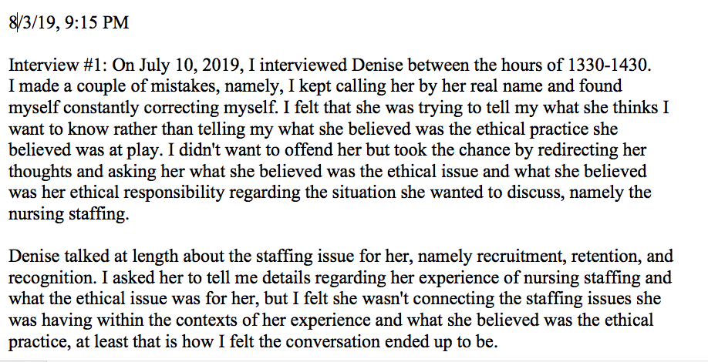
Methodology
Researcher’s Journal
10

Slide 11
Methodology: Data Collection
Examples of Interview Questions
IQ1: What do you believe should be done to protect the vulnerabilities of stakeholders?
IQ2: How do you address the interests of all stakeholders involved?
IQ3: What do you think is your ethical responsibility as a frontline nurse leader?
IQ4: What do you think is the moral foundation for nursing practice?
(Kelly, 1998; YouTube: Markkula Center for Applied Ethics, 2019)
11

Slide 12
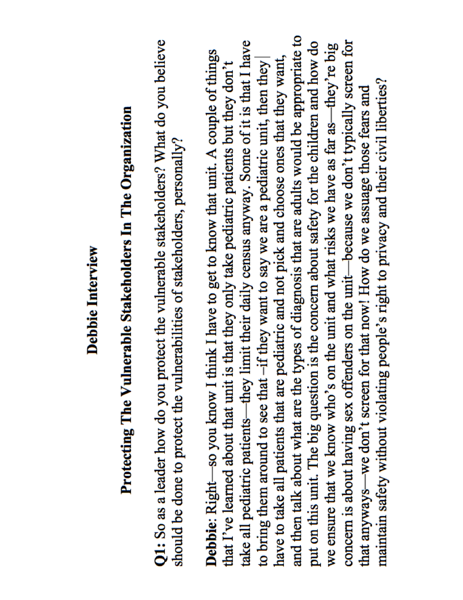
Methodology
Example of Transcript: Question 1
12

Slide 13
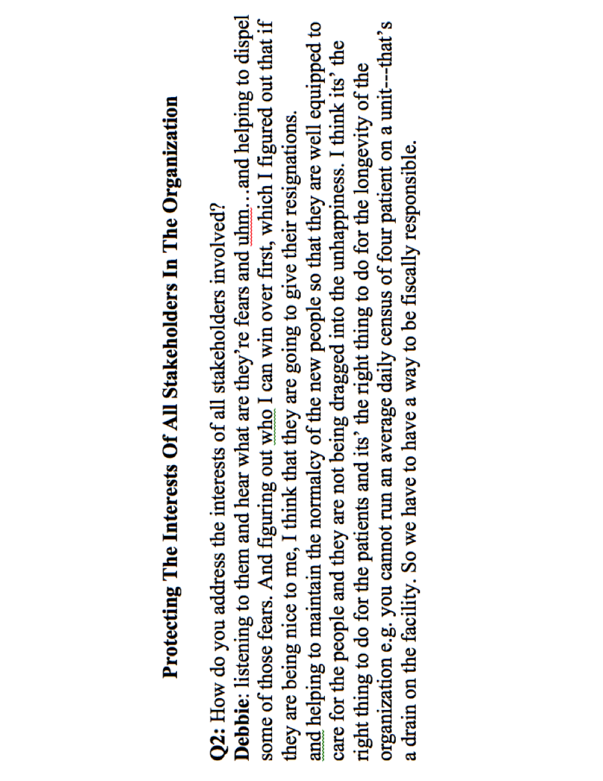
Methodology
Example of Transcript: Question 2
13

Slide 14
Methodology
Data Trustworthiness
Organizing data, e.g., N-Vivo 12 qualitative program
Credibility & Dependability issues: verbatim texts and triangulating sources of data to existing literature
Patterns in identified themes include:
  Keeping patients safe
  Building trust with employees
  Ensuring administrative actions are fair and justified
  Making due with available resources
14

Slide 15
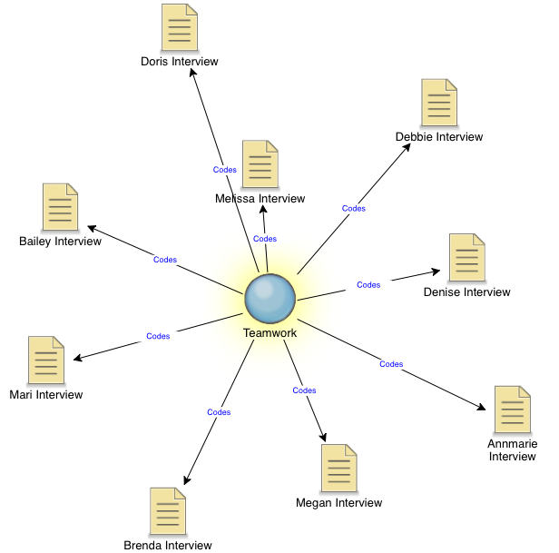
Methodology: Data Analysis
N-Vivo Example 1: Promoting Teamwork
15

Slide 16
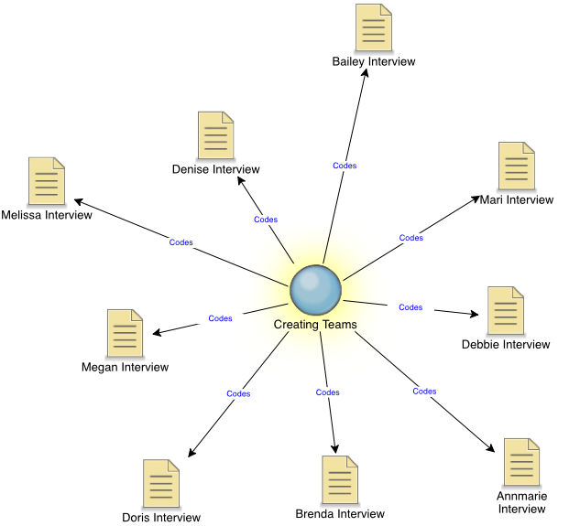
Methodology: Data Analysis
N-Vivo Example 2: Creating Teams: “Hiring the right people”
16

Slide 17
Methods: Data Analysis
N-Vivo Example 3: Communicating Effectively To Build Trust
17

Slide 18


Word Cloud
18

Slide 19
Study Findings
Managerial Ethical Practice At The Frontline Level of Management
Theme 1: Using Teamwork To Keep Patients Safe
Theme 2: Creating Psychologically Safe Environments
Theme 3: Managing Just Practices
Theme 4: Balancing Compromises
Themes characterize and provide structure to managing workplace ethical issues/dilemmas in ethical leadership contexts and practice
19

Slide 20
Example: Study Findings
Theme 1: Using Teamwork To Keep Patients Safe
P6: “They were very fragmented and one thing I wanted to emphasize with them to do and get them thinking was that we should function as a team.”
Working as team allows nurses to keep patients safe under their care.
Theme 1: Using teamwork to keep patients safe
20

Slide 21
Example: Study Findings
Theme 2: Creating Psychologically Safe Environments
P2: “So creating that culture on my unit is creating an environment where nurses do feel that they can feel safe to speak up when something is not going for their patient and creating that safety.”
Create an environment where nurse are not afraid to say they are not comfortable with a situation.
Create a psychologically safe environment to ensure voice behaviors
21

Slide 22
Example: Study Findings
Theme 3: Managing Just Practices
P8: “So it makes me question myself with the delivery of the corrective action. This is all in consultation with my senior leaders, human resources, and other departments. …HR takes a look at how we handle similar situations in other areas that I may not know about and what type of disciplinary action cam down for the employee.”
Collaborating and communicating with others to ensure disciplinary action is fair and just for the employee.
Managing just practices
22

Slide 23
Example: Study Findings
Theme 4: Balancing Compromises
P1: “Like for instance with the Cath lab, we have patients in the outpatient lab that need to stay overnight because they had an intervention for their heart. We may not have discharges that we don’t have capacity for yet. So I have asked them to hold those patients for a little bit until we have the discharges.”
Balancing compromises
Balancing safety concerns with resource constraints
23

Slide 24
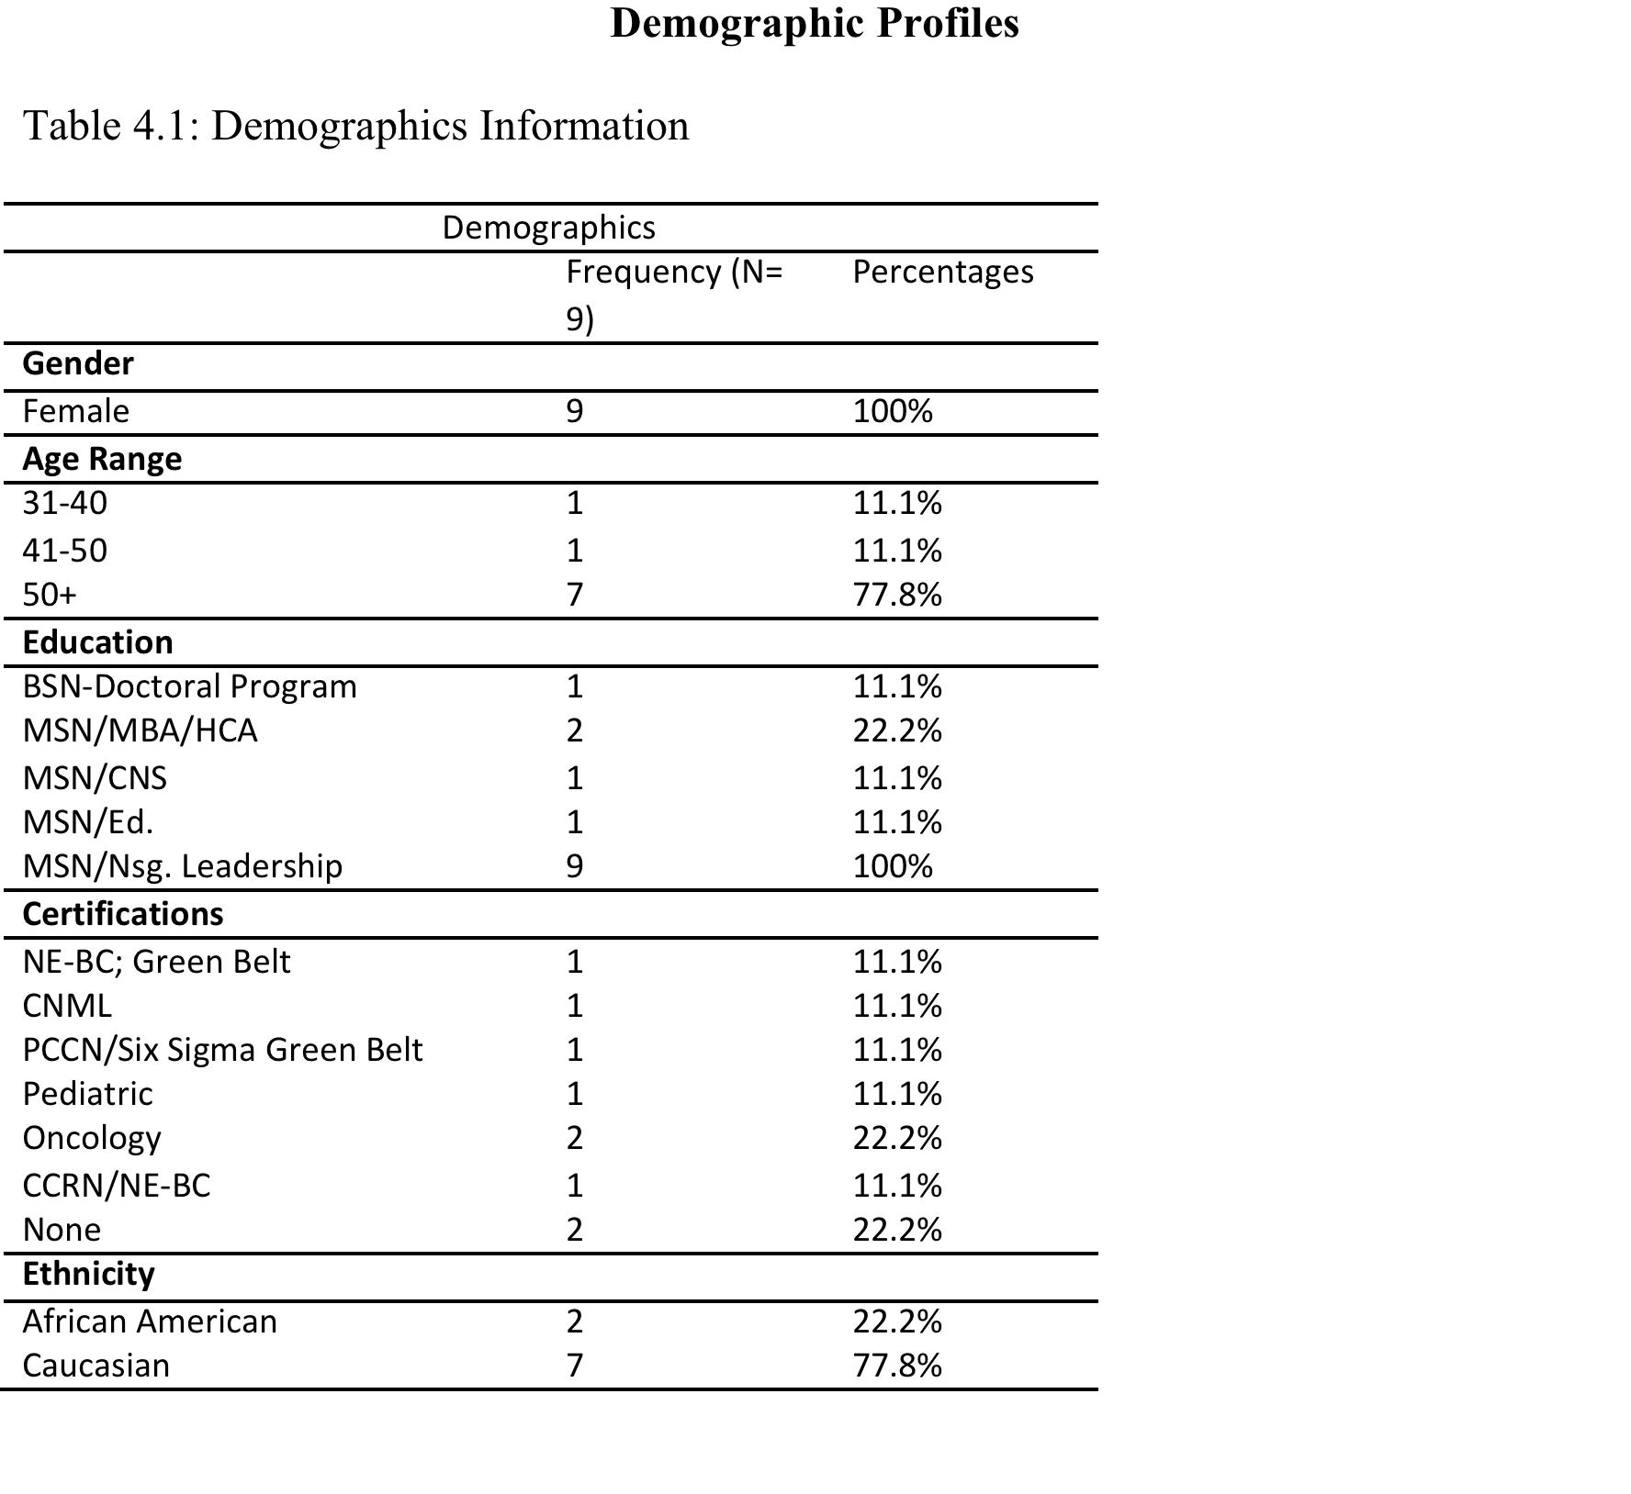
Study Findings
Differences in Demographic Profiles
24

Slide 25
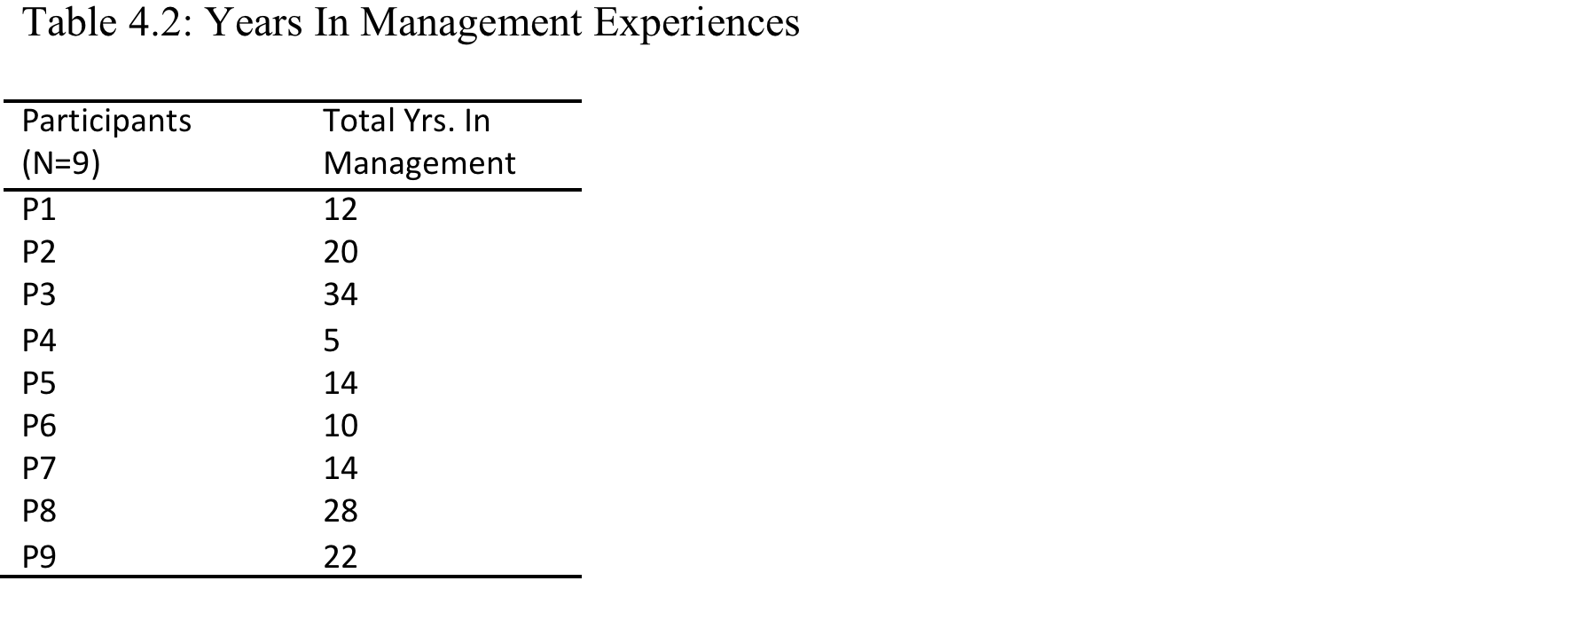
Study Findings: Demographics (continued)
Varying Years in Management Experiences
25

Slide 26
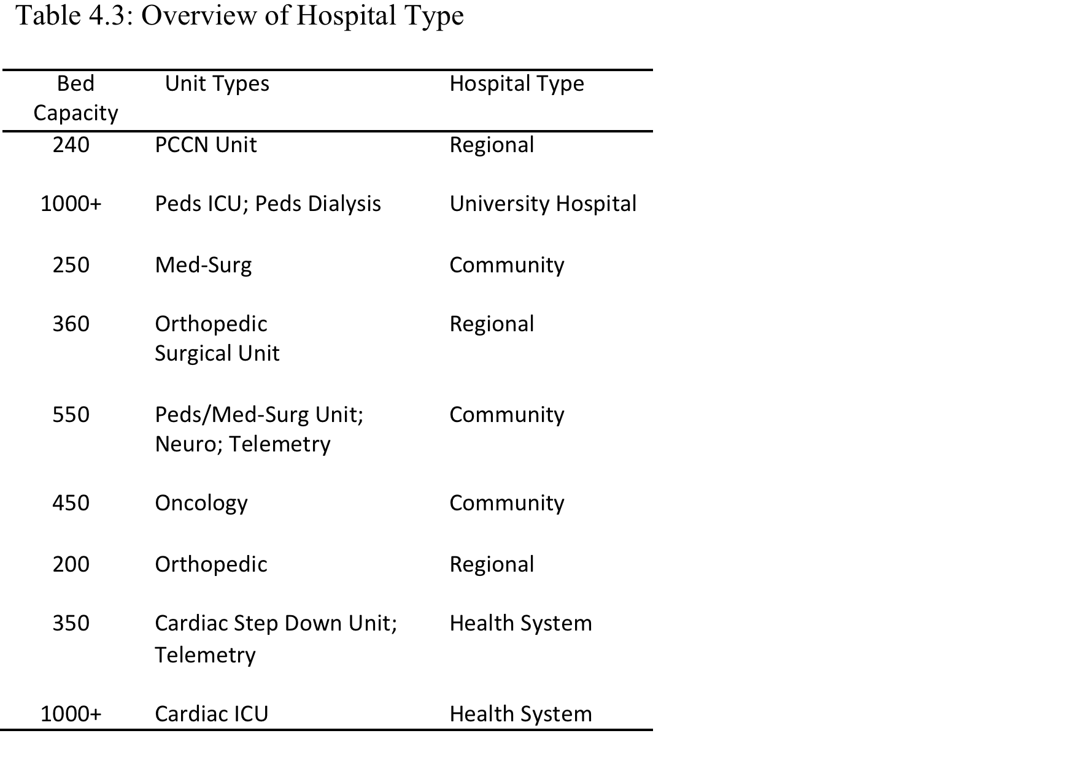
Study Findings
Demographics: Differences in Hospitals of Employment
26

Slide 27
Discussion
Phenomenology Useful to highlight differences in belief systems (attitudes in ethics and leadership)
Value of Method (complex and sensitive topics are difficult for leadership to describe)
Applicability of Method and Usability of Findings- provide foundational knowledge to understand beliefs and reasons for behavioral choices in ethical leadership contexts
27

Slide 28
Discussion
Analysis and Reflection
Value of information obtained
  Demographic differences, e.g., age, gender, ethnicities
  Differences in experiences, e.g., skills, knowledge, and education
Relevance of information
  r/t beliefs and attitudes
  Ethical choices resulting in behavioral actions provided essential themes identified as relevant to essences of experiences in ethical dilemmas
28

Slide 29
Discussion
Applicability and Usability of Study Findings
Relevance of study findings to users of study findings
Differences in experiences, education, and employment histories are notable
Employing hospitals and amount of resources invested by employing hospitals in these managers’ leadership role
29

Slide 30
Discussion
Benner’s Novice-To-Expert Theory helps to explain the differences in skills and expertise in the management role
Theory of Reasoned Action (Fishbein & Ajzen, 1975)
(individual influences)
Beliefs, attitudes, moral intentions, moral judgments, and ethical behavior
Social Cognitive Theory (Bandura, 1989) (organizational or social influences)
Rest’s 4C Model
Moral awareness
Moral intent
Moral motivation
Moral character
Ethical decision-making can be taught by defining the issue in the dilemma (Rest & Narvaez, 1994)
30

Slide 31
Benner’s Novice-to-Expert Theory
Maxims are based on acquired skills, practiced over time them until they become tacit knowledge which Benner called intuition. Through practice skills are advanced until knowledge gained are recognized for the expert level that it demonstrate
Discussion:
Novice
Competent
Expert
Advanced beginner
Proficient
31

Slide 32
Discussion
Frontline Nurse Managers’ Ethical Practice At The Point-Of-Care Model
Using Teamwork To Keeping Patients Safe
Creating Psychologically Safe Environments
Managing Just Practices
Balancing Compromises
32
Notes:
Study findings on ethical practice reveal that frontline nurse managers focus their reasoning process on four themes identified in the current study.

Slide 33
Discussion
Recommendations
Nurses need skills to practice the ethics of care principles. Adding CEUs and nursing education on this topic at the BSN level or new hire level would be helpful.
The nursing administration needs to implement a policy that guides and directs ethical leadership processes.
Nursing ethics education needs a curriculum or implement continuing education units (CEUs) to develop ethical decision-making skills to address ethical dilemmas encountered in the workplace.
More nursing research to determine nurse managers’ use of evidence-based practice for practicing ethical leadership at the point of care.
33

Slide 34
Discussion
Conclusion
Managing the nursing unit is a complicated job.
Ethical leadership shows promise to improving the quality of care practices at the point-of-care.
Ethical practice requires ethical leadership.
Ethical judgment and intentions provides a lens to the reasoning processes of behavioral choices, e.g., ethical or unethical choices viewed by society.
Frontline nurse managers require skills and leadership knowledge and support to develop and nurture an ethical culture, that empowers ethical leadership among nursing staff.
34

Slide 35
References
Agency for Healthcare Research and Quality. (2018). Healthcare Cost and Utilization Project (HCUP). Retrieved from https://www.ahrq.gov/data/hcup/co-level-stats.html
Aitken, L. H., Clarke, S. P., Cheung, R. B., Sloane, D. M., & Silber, J. H. (2003). Educational levels of hospital nurses and surgical patient mortality. JAMA, 290(12), 1617-1623. Retrieved from https://www.jama.com
American College of Emergency Physicians (ACEP). (n. d.). The ethics of Health Care Reform: Issues in emergency medicine. Retrieved from https://www.acep.org/Content.aspx?id=80871#sm.001s8ct771bvld3avsc2ehubgkub0
American College of Healthcare Executives (ACHE). (2015). Creating an ethical culture within healthcare organization. Retrieved from https://www.ache.org/policy/environ.cfm
Bandura, A. (1989). Social cognitive theory. In R. Vasta (Ed.), Annals of child development. Vol. 6. Six theories of child development (pp. 1-60). Greenwich, Ct: JAI Press. (Retrieved from https://www.uky.edu/~eushe2/Bandura/Bandura1989ACD.pdf)
Benner, P. (1984). From novice to expert: Excellence and power in clinical nursing practice. Menlo Park, CA: Addison-Wesley Publishing Co.
Blitchok, A. (2018). Proposed Federal RN ratios: What you can do about it. Retrieved from https://nurse.org/articles/federal-staffing-ratios/
Brown, M. E., & Mitchell, M. S. (2010). Ethical and unethical leadership: Exploring new avenues for future research. Business Ethics Quarterly, 20(4), 583-616. http://doi.org/10.5840/beq201020439
35

Slide 36
References
Brown, M. E., & Trevino, L. K. (2006). Ethical leadership: A review and future directions. The Leadership Quarterly, 17, 595-616. Doi: 10.1016/j.leaqua.2006.10.004
Current trends in ethics. (2019). Markkula Center for Applied Ethics. Retrieved from YouTube.com
Directory of nurses with expertise in ethics, (n.d.). John Hopkins Berman Institute of Bioethics. Retrieved from http://www.bioethicsinstitute.org/nursing-ethics-summit-report/ethics-expert-database
Fishbein, M., & Azjen, I. (1975). Belief, attitude, intention, and behavior: An introduction to theory and research. Reading, MA: Addison-Wesley Publishing Co.
Harder, B. (2019). 2019-20 Best hospitals honor roll and medical specialties rankings. U. S. News Retrieved 1/27/20 from https://health.usnews.com/health-care/best-hospitals/articles/best-hospitals-honor-roll-and-overview
Howieson, W. B. (2019). What is leadership? An academic perspective. In An academic perspective, Leadership (pp. 35-149). Emerald Publishing limited. https: //doi.org/10.1108/978-1-78769-785-020191003.
Islan, T., Ahmed, I., & Ali, G. (2017). Effects of ethical leadership on bullying and voice behavior among nurses: Mediating role of organizational identification, poor working condition and workload. Leadership in Health Services, 32(1), 2-17. DOI 10.1108/LHS-02-2017-0006
36

Slide 37
References
Kelly, B. (1998). Preserving moral integrity: A follow-up study with new graduate nurses. Journal of Advance Nurses, 28(5), 1134-1145. PubMed. Retrieved from https://www.ncbi.nlm.nih.gov/pubmed/9840887
Khalid, K., Eldakak, S. E., & Loke, S. P. (2017). A structural approach to ethical reasoning: The integration of moral philosophy. Academy of Strategic Management Journal, 16(1), 81-113.
Health Care Cost Institute. (2016). 2016 Health care cost and utilization report: A review of trends in health care spending, utilization, and price among Americans with employer-sponsored insurance. Retrieved from https://healthcostinstitute.org/annual-reports/2016-health-care-cost-and-utilization-report
Rest, J. R., & Narvaez, D. (1994). Moral development in the professions: Psychology and applied ethics. Hillsdale, NJ: Lawrence Erlbaum Associates, Publishers
Ryan, J. J. (2001). Moral reasoning as a determinant of organizational citizenship behaviors: A study in the public accounting profession. Journal of Business Ethics, 33(3), 233-244. ProQuest Central.
Suhonen, R., Stolt, M., Virtanen, H., & Leino-Kilpi, H. (2011). Organizational ethics: A literature review. Nursing Ethics, 18(3), 285-303. 10.1177/0969733011401123
37

Slide 38
Questions???
38

Slide 39
Thank you
39

Slide 40
Contact Information
Jennifer Fosty, Ph. D., RN, OCN
37 Rolling Lane
Levittown, NY 11756
Email: jf3263@yahoo.com
Tel: 516-987-5518

