Slide 1
Constructing Editorial Comments Collaboratively or Meaningful Moments in the Margins
The Qualitative Report Best Practices Series
Ronald J. Chenail, Editor-in-Chief
Sally St. George, Senior Editor

Slide 2
The Qualitative Report (TQR) Best Practices Series
We designed these presentations to help our editors and reviewers learn the TQR approach to helping authors improve their articles and to learn and utilize best practices in reporting their research studies. We also hope authors consult these resources as they prepare their papers for submission.
As a learning community, we feel our mission is not only to help authors learn how to write better, reviewers how to review better, and editors how to edit better, but also to help our readers to appreciate the aesthetic qualities of a paper well-written.
Please feel free to use these resources in your teaching and learning!

Slide 3
The Qualitative Report Editorial Board Commitment to Quality
Help authors improve their qualitative research reporting
Utilize “best practices” in contemporary qualitative research practice and presentation
Publish articles reflecting the best quality in qualitative research
Maintain supportive and respectful relations

Slide 4
TQR 5 C’s for Quality
Creativity
Control
Clarity
Consistency
Coherence

Slide 5
Constructing Editorial Comments Collaboratively

Slide 6
TQR Editorial System
Reviewer
Read
Comment
Team-Leading Editor
Read
Comment
Senior Editor
Read
Comment
Advise
Advise
Advise

Slide 7
TQR Editorial System
Reviewer
T-L Editor
Senior Editor
Editor-in-Chief
Read-Comment-Advise-Decide

Slide 8
Tools of Our Trade: Microsoft Word Review

Slide 9
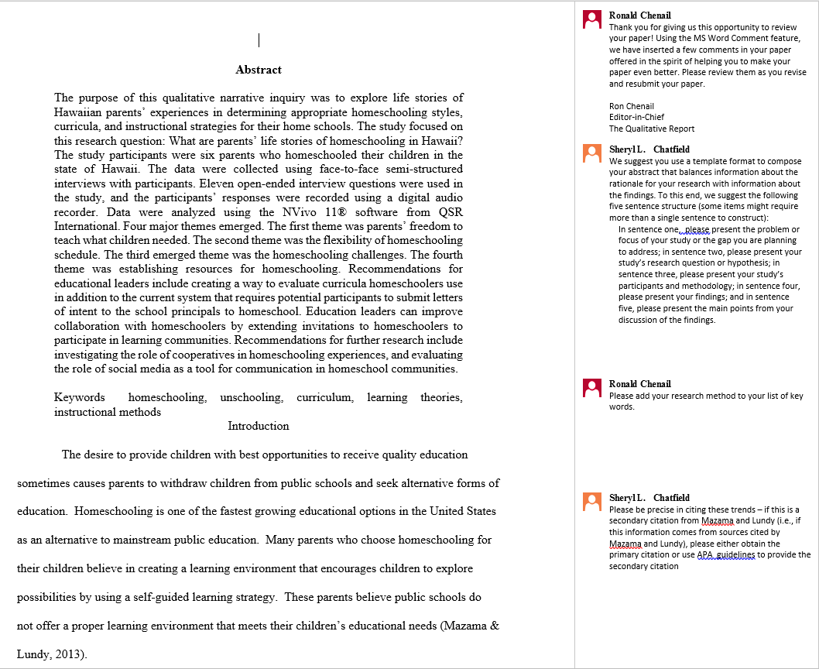

Slide 10
Styles
Ready Review Comments
Writing Conventions
Reading Appreciation

Slide 11
The Qualitative Report TQR Ready Review Comments
To help you as a reviewer for TQR, we have composed this guide to help you articulate the journal editorial baord’s collective perspective on quality in qualitative research practice and reporting. We offer these comments in the spirit of helping you create an informative review. You are encouraged to incorporate relevant items into your commentary on the paper and to customize them to better address the particular issues you have identified in your author’s paper. We do ask that you not merely “cut and paste” our comments into your review without thoughtfully considering the context of those comments.
https://cpb-us-e1.wpmucdn.com/sites.nova.edu/dist/a/4/files/2018/08/TQR_Ready_Review_Comments_081118-1ba7vsy.pdf

Slide 12
Building a respectful supportive relationship
Thank you for giving us this opportunity to review your paper! Using the MS Word Comment feature, we have inserted a few comments in your paper offered in the spirit of helping you to make your paper even better. Please review them as you revise and resubmit your paper.
Ron Chenail
Editor-in-Chief
The Qualitative Report
Thank you for your revised manuscript! We appreciate the work you have put into improving your paper! As you can see below, we still have some ways in which we would like you to enhance your paper. In revising your paper, please use the Comments tool to insert responses to our comments to let us know how you revised the text of the paper.
Ron Chenail
Editor-in-Chief
The Qualitative Report

Slide 13
Ready Review Comments
Before moving on to Methods we ask all authors to provide a brief discussion of their own context. This is based on a belief that who you are and how you are involved with the topic and study will influence the presentation. We want readers to have a fair understanding of the researcher to make the fullest evaluation of the study and to have greater confidence in what they are about to read. Toward that end, please tell us your relationship to this inquiry. Who are you? What is your interest in this topic? What is your investment in this project? What are your intentions?
Please provide a statement of third-party approval that you secured to conduct this study (e.g., Institutional Review Board for the Protection of Human Subjects) or if your local context does not require such oversight, then please indicate this and describe how you ensured ethical research practice to protect participants’ safety, privacy, and confidentiality. If the study was deemed to be exempted or excluded from IRB review, please make note of it.

Slide 14
APA Matters
Please double check formatting of ellipsis throughout your manuscript. Thank you.
Please consult APA so that all hyphens are properly formatted. Thanks.
We use APA formatting. Please revise the formatting of anything in a series.
In APA, research reports end with the Discussion section, so please either delete your Conclusion or weave that information into one of your Discussion section elements.

Slide 15
Writing matters too
For clarity purposes in writing, please use active voice and first or third person pronouns to express attribution. For example, here, it would be much clearer to write, “We used a multicase approach…” Please see pages 68-70 in the APA Publication Manual for more detail on this style of writing.

Slide 16
Let them know your reading their paper
I do not recall seeing this in the description of your analytical process.
What does this refer to?
I don’t see these words listed in above table.
We need to see every step that you took including who conducted which steps. Please demonstrate how you transformed data through analysis into results. Please include examples of your processes to make it even more vivid.

Slide 17
Show your appreciation!
I really appreciate this – it clearly conveys how envisioning relies on believing you might have some control over the future – or that you might have a future at all. I would imagine there is much in the addiction and recovery literature to support this idea, to help connect Shane’s story to others’ experiences and the literature.
I appreciate the contrast here. Above with envisioning before is lack, present is replete. Here, urgency is recast after recovery, experienced differently. Nicely done.

Slide 18
Editor Comments
Novel
Reflective
Supportive
Collaborative

Slide 19
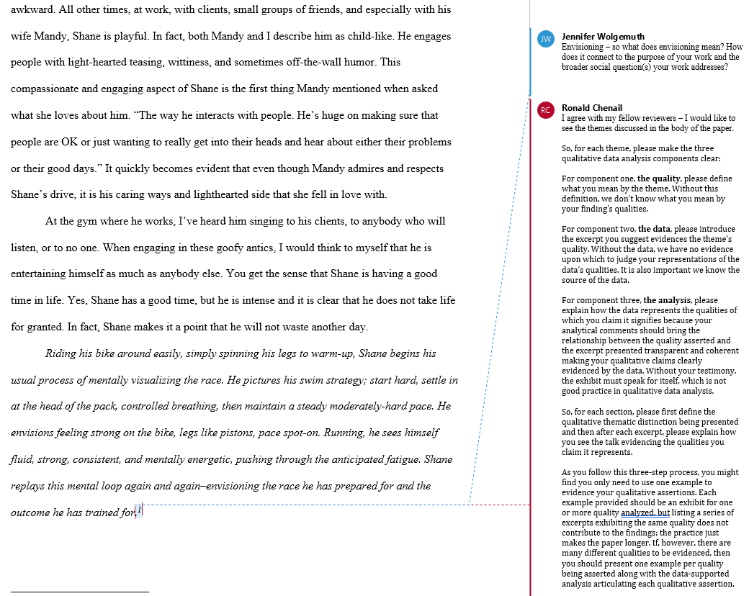

Slide 20
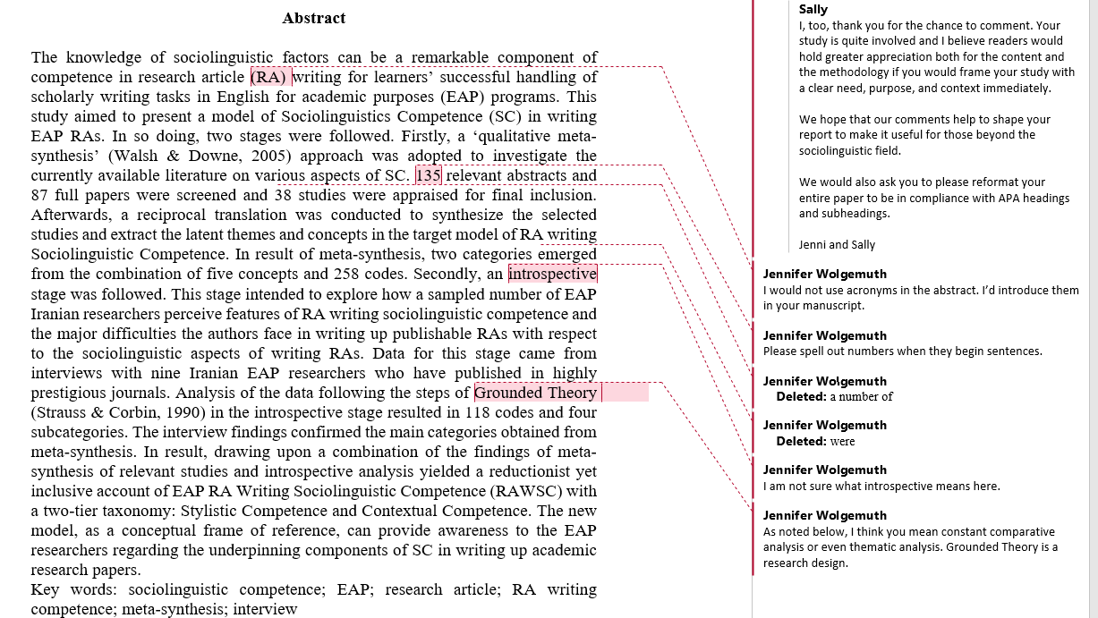

Slide 21
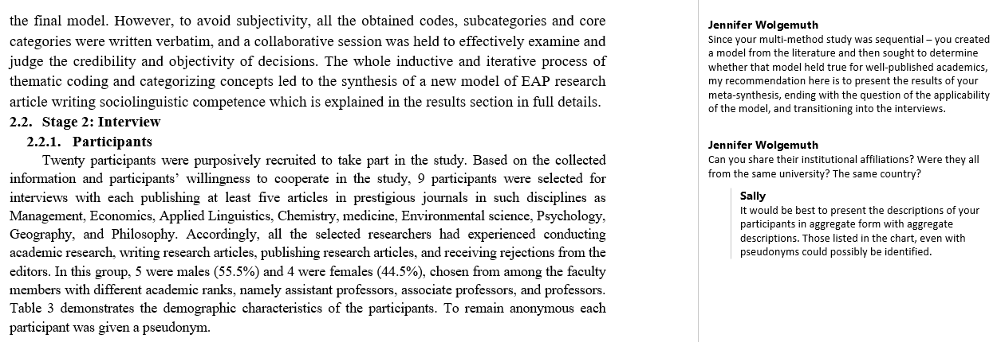

Slide 22
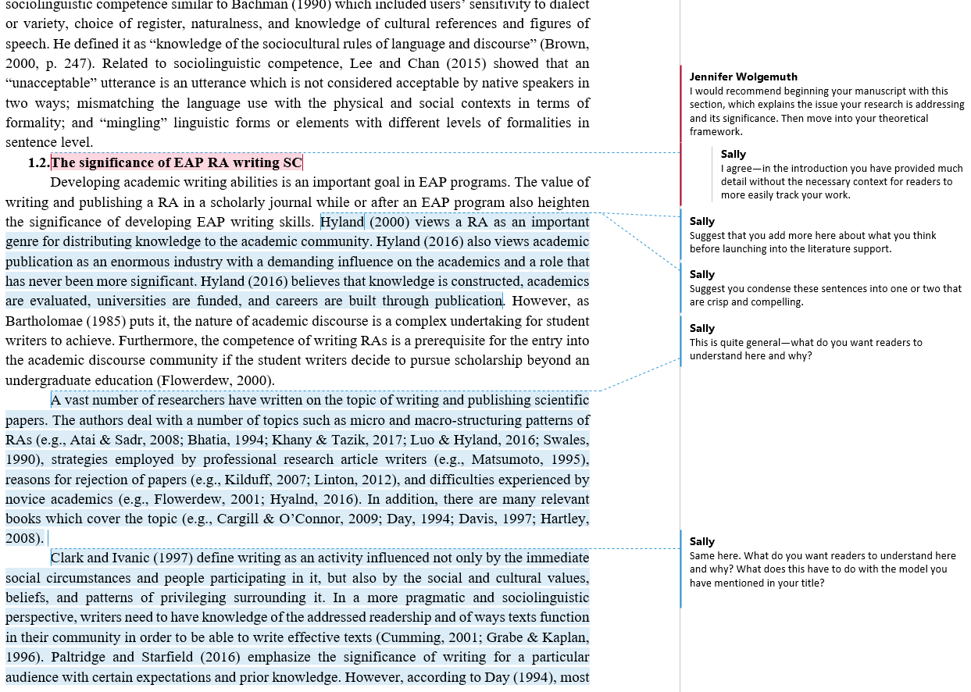

Slide 23
Collaborating Towards Quality
Author
Reviewer
Team-Leading Editor
Senior Editor
Editor-in-Chief

Slide 24
Questions, Comments, Suggestions

Slide 25
Contact Information
Ron Chenail, PhD
The Qualitative Report: https://tqr.nova.edu/
Nova Southeastern University
Graduate School of Arts, Humanities and Social Sciences
3301 College Avenue
Fort Lauderdale, Florida USA 33314
Phone: 954.262.3019
Email: ron@nova.edu

